Slide 1
Transforming steering controls to self driving
Week 5 report
Hongshuo Wang
Professor Siu Ling Leung

Slide 2
Object Detection
Determine the way of implementation
Collect the data
Train the model
Visualize
Move to jetbot

Slide 3
Tensorflow vs Pytorch
https://medium.com/swlh/nvidia-jetson-nano-custom-object-detection-from-scratch-using-tensorflow-and-opencv-113fe4dba134
https://pytorch.org/tutorials/intermediate/torchvision_tutorial.html

Slide 4
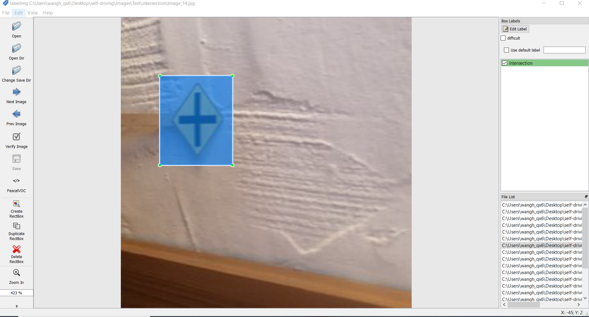
Collecting Data
I use the previous classification project’s image.
Use Labellmg to draw the bounding box manually
Use seperate data in 45 images per class (total 225 images)
15 images per class as the valiedation sets (total 75 images)

Slide 5
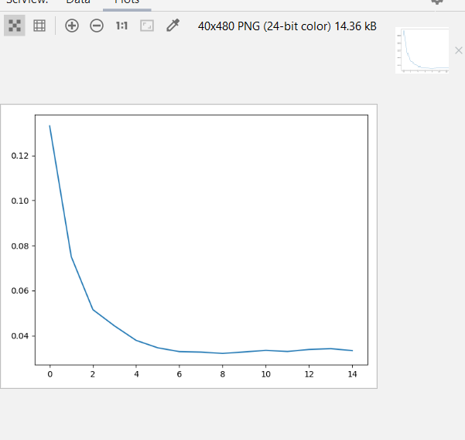
Run Detecto
Create the dataset and train the model

Slide 6
Visualize

Slide 7
Reference
https://pytorch.org/tutorials/intermediate/torchvision_tutorial.html
https://medium.com/pytorch/detecto-build-and-train-object-detection-models-with-pytorch-5f31b68a8109
https://medium.com/swlh/nvidia-jetson-nano-custom-object-detection-from-scratch-using-tensorflow-and-opencv-113fe4dba134

